Slide 1
CM1605 Web Technology
JavaScript and DOM,
JavaScript Event Listeners and Callbacks
Week 7.1| Janani Harischandra

Slide 2
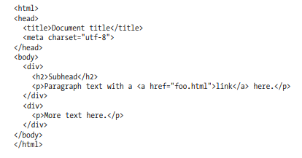
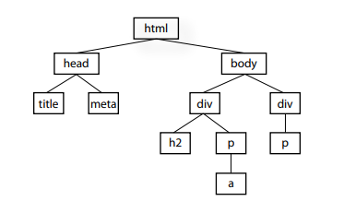
DOM
A simple way to think of the DOM is in terms of the document tree.

Slide 3
HTML DOM Events
HTML DOM events allow JavaScript to register different event handlers on elements in an HTML document.
Events are normally used in combination with functions, and the function will not be executed before the event occurs (such as when a user clicks a button).
Some common uses of events
When a user clicks the mouse
When a web page has loaded
When an image has been loaded
When the mouse moves over an element
When an input field is changed
When an HTML form is submitted
When a user strokes a key

Slide 4
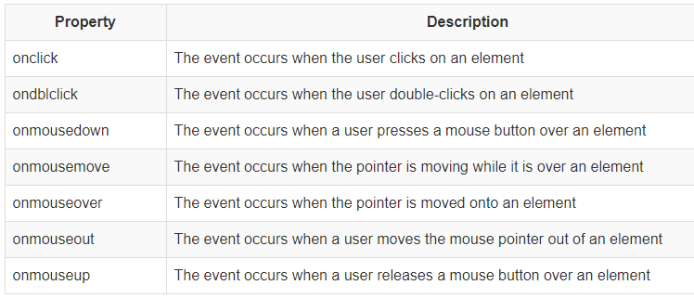
Mouse Events

Slide 5
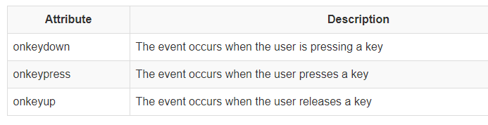
Key Board Events

Slide 6
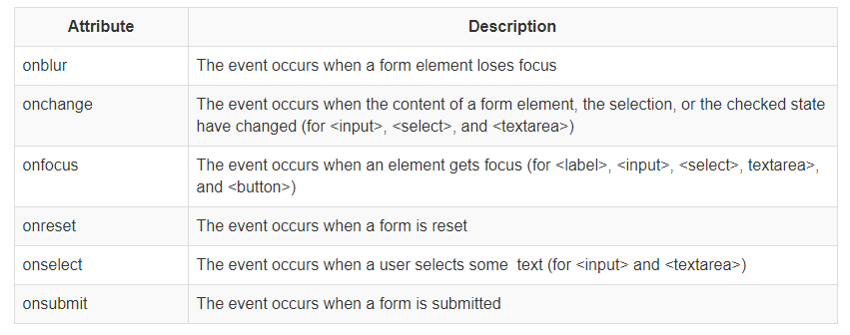
Form Events

Slide 7
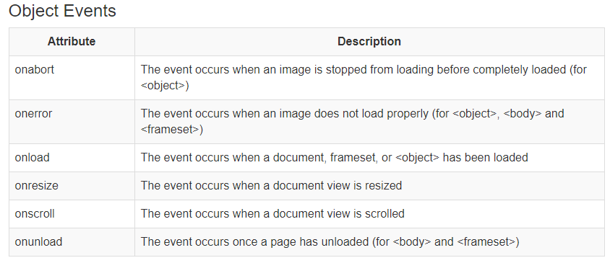
Object Events

Slide 8

Reacting to Events
A JavaScript can be executed when an event occurs, like when a user clicks on an HTML element.
To execute code when a user clicks on an element, add JavaScript code to an HTML event attribute:

Slide 9

the setTimeout() method
The window.setTimeout() method can be written without the window prefix.
The setTimeout() method will wait the specified number of milliseconds, and then execute the specified function.
The first parameter of setTimeout() should be a function.
The second parameter indicates how many milliseconds, from now, you want to execute the first parameter.

Slide 10
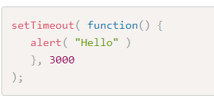
Example
Wait 3 seconds, then alert "Hello“:

Slide 11
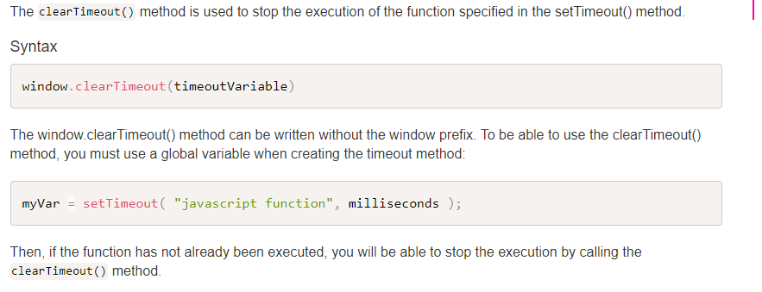
How to Stop the Execution?

Slide 12
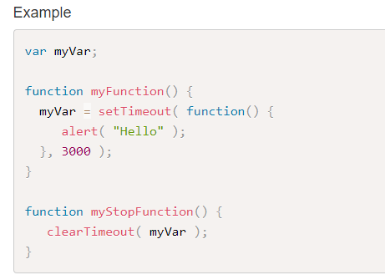
Example

Slide 13
The addEventListener() method
We have used DOM events previously by adding listeners directly in the html element.
However, in order to totally separate the HTML from the JavaScript code, it is better practice to add the event Listener inside the JavaScript code by using the addEventListener() method.
This improves separation of concerns, readability and allows you to add the event listeners and effects even if you do not have control over the HTML code.
The addEventListener() method attaches an event handler to a specified element.
It will not overwrite existing event handlers on that element, so it is possible to add many event handlers to one element, including more than one identical event handler (e.g. you can add two click event listeners to the same element).
The other advantage of using the addEventListener() method, is that you get control of the event bubbling (how the event propagates through the DOM nodes).
You can remove an event listener by using the removeEventListener() method.

Slide 14
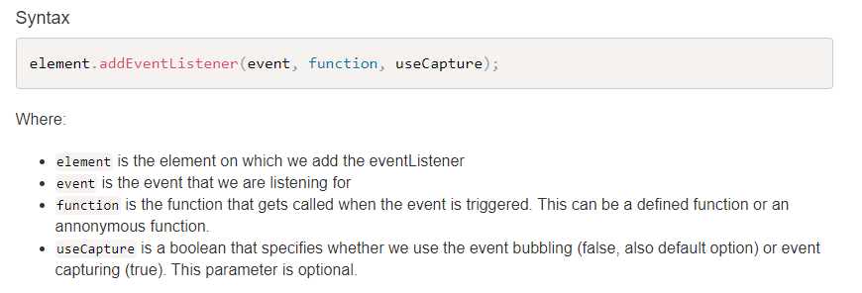
The addEventListener() method

Slide 15
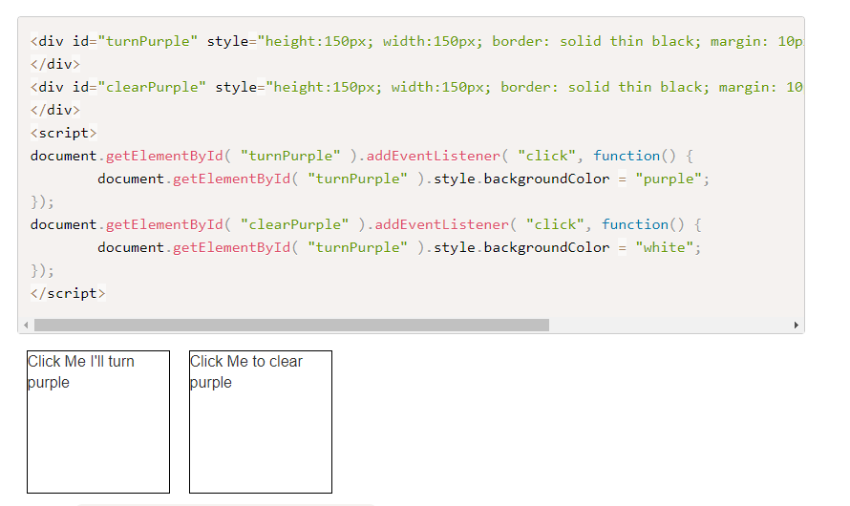
Example – Change Background color

Slide 16
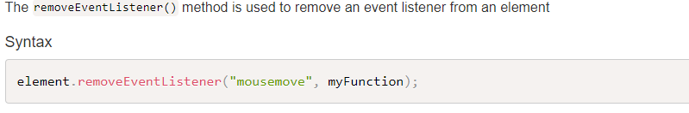
The removeEventListener() method

